Slide 1
Lab 4: Data Analyzing
Jericho Perdon
Prof Scrivnor
Comp 429
1 March 2021

Slide 2
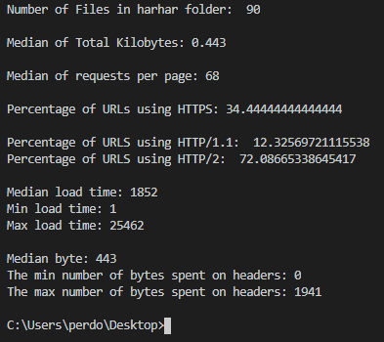
Task 2 Results

Slide 3
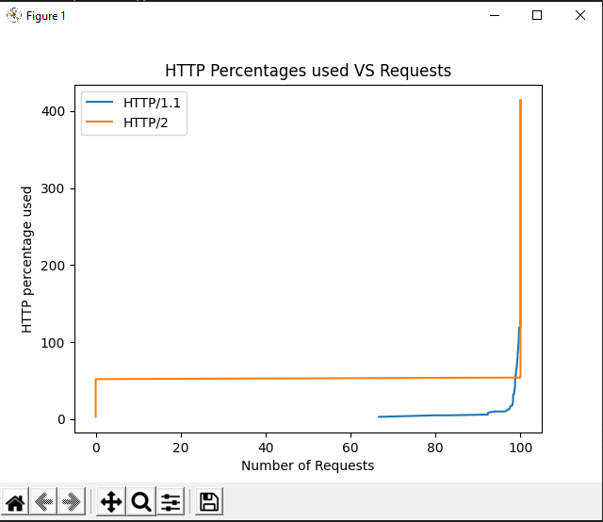
Task 3 Plot
Attempt at plotting the data of HTTP/1.1 and HTTP/2 URLs

